Slide 1
Dynamic Memory Allocation

Slide 2
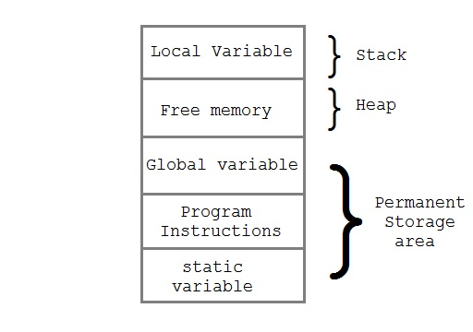
Memory Allocation Process

Slide 3
In static memory allocation, the allocated memory size is fixed at compile time.
Dynamic memory allocation is the process of allocating memory at run time.
Heap is used for dynamic memory allocation during execution of the program. The size of heap keep changing.

Slide 4
There are four library functions in C through which dynamic memory allocation can be done.
These are malloc(), calloc(), realloc(), and free().
We need to include the header file <alloc.h> in TC and the header file <malloc.h> in VC to use these functions.

Slide 5
size_t
The size_t type is defined in stdio.h, stddef.h, stdlib.h, and string.h.
This type is used for defining the sizes of strings and memory blocks. It is defined as:
typedef unsigned int size_t;
and is used as shown in the following example:
  #include <string.h>
  void lfunc (char *string)
  {
    size_t string_length;
    string_length = strlen(string);
  }

Slide 6
malloc()
Declaration: void *malloc(size_t size);
Remarks:
malloc allocates a contiguous block of size bytes from the memory.
It allows a program to allocate memory explicitly as it's needed, and in the exact amounts needed.
Return Value:
On success, malloc returns a pointer to the newly allocated block of memory.
It returns a pointer of type void. This means that we can assign it to any type of pointer. It takes the following form:
ptr=(cast-type*)malloc(byte-size);
Where ptr is a pointer of type cast-type. The malloc returns a pointer of cast-type to an area of memory with size byte-size.

Slide 7
For examle:
x=(int*)malloc(100*sizeof(int));
On successful execution of this statement, a memory space equivalent to “100 times the size of an int” bytes is reserved and the address of the first byte of the memory allocated is assigned to the pointer x of type int.
On error (if not enough space exists for the new block), malloc returns NULL.
If the argument size == 0, malloc returns NULL.

Slide 8
#include <stdio.h>
#include <string.h>
#include <alloc.h>
#include <process.h>
main()
{
char *str;
/* allocate memory for string */
if ((str = (char *) malloc(10*sizeof(char))) == NULL)
{
printf("Not enough memory to allocate buffer\n");
exit(0); /* terminate program if out of memory */
}

Slide 9
/* copy "Hello" into string */
strcpy(str, "Hello");
/* display string */
printf("String is: %s\n", str);
/* free memory */
free(str);
}

Slide 10
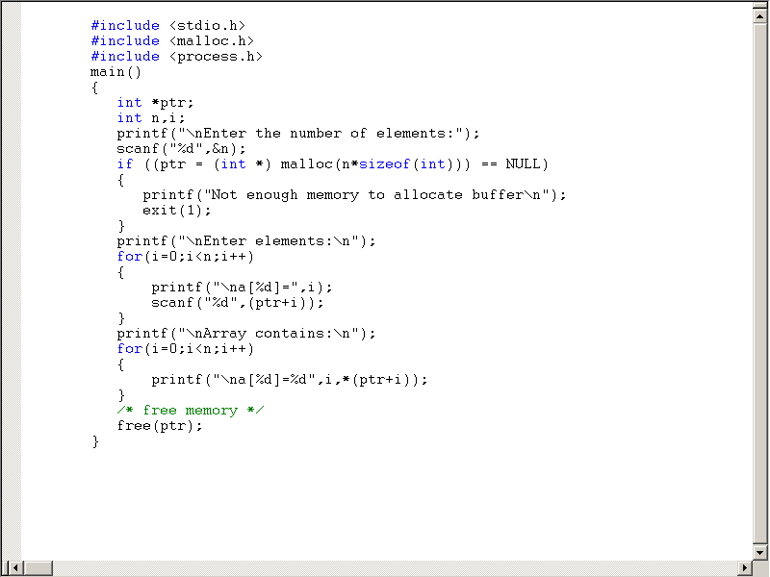

Slide 11
calloc()
Declaration:
void *calloc(size_t nitems, size_t size);
Remarks:
calloc( ) allocates a contiguous block (nitems * size) bytes and sets all bytes to zero.
Return Value:
On success, returns a pointer to the newly allocated block.
On failure (not enough space exists for the new block, or nitems or size is 0), returns NULL.

Slide 12
#include <stdio.h>
#include <alloc.h>
#include <string.h>
main( )
{
char *str;
/* allocate memory for string */
str = (char *) calloc(10, sizeof(char));
/* copy "Hello" into string */
strcpy(str, "Hello");
/* display string */
printf("String is %s\n", str);
/* free memory */
free(str);
}

Slide 13
realloc()
Declaration:
void *realloc(void *block, size_t size);
Remarks:
realloc adjusts the size of the allocated block to size, copying the contents to a new location if necessary.
Return Value:
On success, realloc returns the address of the reallocated block, which might be different from the address of the original block.
On failure (if the block can't be reallocated, or if size == 0 ), the function returns NULL.

Slide 14
#include <stdio.h>
#include <alloc.h>
#include <string.h>
main()
{
char *str;
/* allocate memory for string */
str = (char *) malloc(10);
/* copy "Hello" into string */
strcpy(str, "Hello");
printf("String is: %s and Address is: %u\n", str, str);
str = (char *) realloc(str, 20);
printf(“After realloc, String is: %s and New address is %u\n", str, str);
/* free memory */
free(str);
}

Slide 15
OUTPUT in VC
String is: Hello and Address is: 4391264
After realloc, String is: Hello and New address is 4391264
Press any key to continue
OUTPUT in TC
String is: Hello and Address is: 1472
After realloc, String is: Hello and New address is 1486
Press any key to continue

Slide 16
free()
Declaration:
void free(void *block);
Remarks:
free deallocates a memory block allocated by a previous call to calloc, malloc, or realloc.
Return Value: None

